Slide 1
LWC Training
Migrating Aura
to LWC
MAY 09, 2019
Day 2 : Migrating Aura to LWC

Slide 2
Today’s Objectives
agenda
Migration Strategy
Migrate Markup
Migrate Component Bundle
Migrate CSS
Migrate Events

Slide 3
Migration Strategy

Slide 4
Migration Strategy - Overview
Migration strategy
The programming model for Lightning Web Components is fundamentally different than the model for Aura components. Migrating a component is not a line-by-line conversion, and it's a good opportunity to revisit your component's design. Before you migrate an Aura component, evaluate the component’s attributes, interfaces, structures, patterns, and data flow.
The easiest components to migrate are simple components that only render UI. You get more gains in performance and developer productivity by migrating larger trees of components (components within components) rather than an individual component. However, it's a useful learning experience to migrate one component and see how concepts in the Aura programming model map to concepts in the Lightning Web Components programming model.
After migrating one component, you'll be in a better position to determine whether it makes sense for you and your org to:
Undertake a larger migration effort
Use Lightning web components for new components only
Stick with Aura components for now
The choice is down to you and differs for everyone, depending on use cases and available resources. Whatever decision you make, migrating a component is a valuable learning exercise.
Continued……….

Slide 5
Migration Strategy - Considerations
Migration strategy
If you are building brand new functionality, you should look at building with LWC first. Your applications will get the benefit of increased native operation in the browser, which translates to faster app performance and more functionality.
In live system cases where performance is really important to a components success, you should probably consider switching to LWC’s. LWC’s will take advantage of native web standards that exist in the browser. This means there is no added abstraction layer, like the Aura framework to slow things down.
Most important facts about how LWC and Aura components work together :
Lightning web components and Aura components can co-exist in the same runtime
An Aura component can contain a Lightning web component
A Lightning web component can’t contain an Aura component
Lightning Web Components is built on current web standards which exposed developers with the modern and advanced JavaScript features . Lightning Web Components demonstrate better security as they add CSS isolation, script isolation, DOM isolation, and a more limited event scope.
For most part, all the mainstream modern browsers support these web standards. However, Edge still do not fully support all these web standards. So, if your organization still uses one of the older browsers or older versions, Lightning web components may not be useful right away
Since LWC’s utilize common web standards, it might be easier to transition existing developers to using LWC’s because there is no additional framework to learn

Slide 6
Migration Strategy
Migration strategy
Pattern #1:
Swap and go
Best for: individual components with little to no JavaScript
Swap HTML syntax from your Aura component for the direct counterpart in your new Lightning web component
Best for: individual components with JavaScript files
Refactor discreet controller and helper files into a single, coherent ES6 module
Migrate supported interfaces to XML tags in your component *.js-meta.xml file
Use Lightning Data Service instead of Apex for single record patterns when possible Convenient CLI commands
Use Apex invocations decorated with @wire when possible
when possible Convenient CLI commands
Use Apex invocations decorated with @wire when possible.
Pattern #2: Redesign, then rebuild
Best for: Complex components with multiple child hierarchies, deeply nested component hierarchies
Start with lowest-level child component and continue migration at the same level of component
Continue working up the hierarchy from the bottom
Apply principles of the above patterns to components within your hierarchies.
Pattern #3: START from the BOTTOM up

Slide 7
Migrate Markup

Slide 8
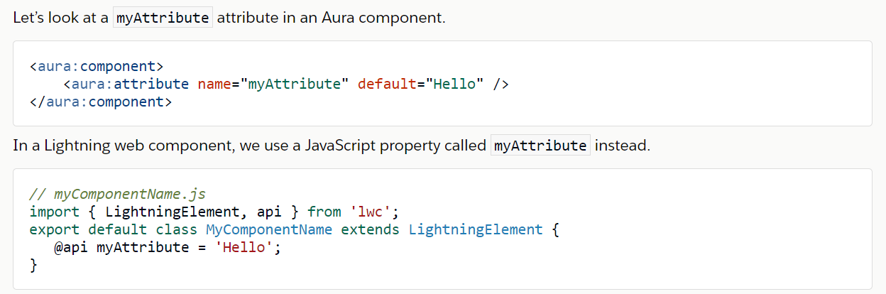
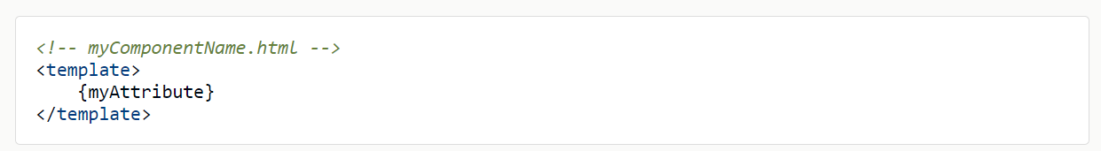
Migrate Attributes
Migration markup
Migrate attributes from <aura:attribute> tags in an Aura component to JavaScript properties in a Lightning web component.
Notes:
ASG – Would need to be ready by Juen for the certified to sell – 3 mo in certified to sell. To show it off at dreamforce 2019.
App exchange I splanned for the solution. If it’s just an asset then they want to review our architecture.
We don’t’ want this on the app exchange.
Approval is all of us, Chandu,. He delegated Subhojit to be our architect.
LWC v Aura – need to be able to regenerate the components with a future technology if needed. Kiran, is the look and feel different, how would that be done?
Security is not yet future proof
Vivek – security team – AERS design
Could we add Louisiana in the mix, to design not to break it in the future – master mapping exercise in the govCONNECT model – if you’re a state with x, here is how you would map to our roles
Let’s make conscious decisions together.
CO – you configure the call, and ti calls an interface, and the framework handles how to call the interface and the elments that are prepopulated.

Slide 9
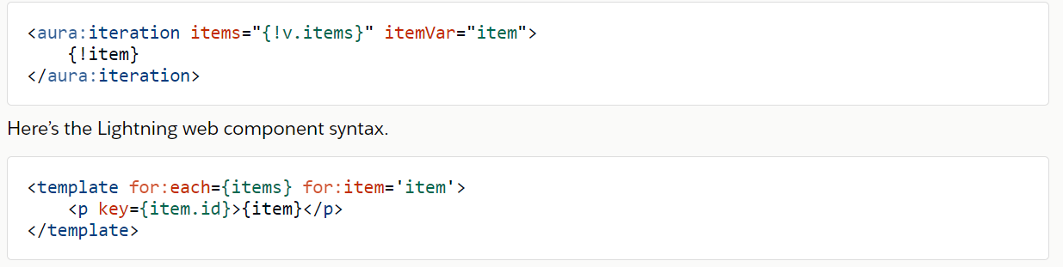
Migrate Iterations
Migration markup
Migrate <aura:iteration> tags in an Aura component to for:each in a Lightning web component.
Notes:
ASG – Would need to be ready by Juen for the certified to sell – 3 mo in certified to sell. To show it off at dreamforce 2019.
App exchange I splanned for the solution. If it’s just an asset then they want to review our architecture.
We don’t’ want this on the app exchange.
Approval is all of us, Chandu,. He delegated Subhojit to be our architect.
LWC v Aura – need to be able to regenerate the components with a future technology if needed. Kiran, is the look and feel different, how would that be done?
Security is not yet future proof
Vivek – security team – AERS design
Could we add Louisiana in the mix, to design not to break it in the future – master mapping exercise in the govCONNECT model – if you’re a state with x, here is how you would map to our roles
Let’s make conscious decisions together.
CO – you configure the call, and ti calls an interface, and the framework handles how to call the interface and the elments that are prepopulated.

Slide 10
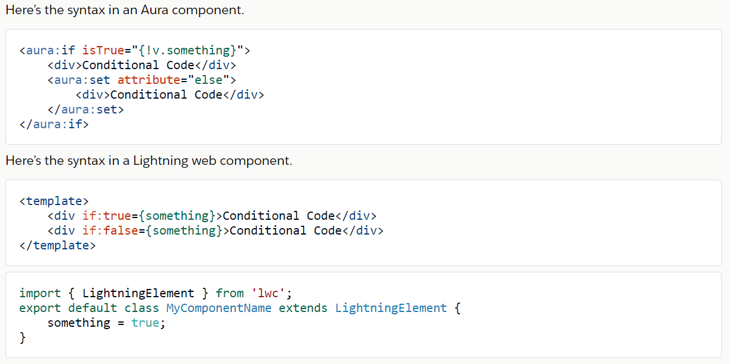
Migrate Conditionals
Migration markup
Migrate <aura:if> tags in an Aura component to if:true and if:false in a Lightning web component.
Notes:
ASG – Would need to be ready by Juen for the certified to sell – 3 mo in certified to sell. To show it off at dreamforce 2019.
App exchange I splanned for the solution. If it’s just an asset then they want to review our architecture.
We don’t’ want this on the app exchange.
Approval is all of us, Chandu,. He delegated Subhojit to be our architect.
LWC v Aura – need to be able to regenerate the components with a future technology if needed. Kiran, is the look and feel different, how would that be done?
Security is not yet future proof
Vivek – security team – AERS design
Could we add Louisiana in the mix, to design not to break it in the future – master mapping exercise in the govCONNECT model – if you’re a state with x, here is how you would map to our roles
Let’s make conscious decisions together.
CO – you configure the call, and ti calls an interface, and the framework handles how to call the interface and the elments that are prepopulated.

Slide 11
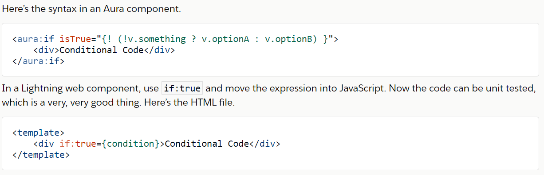
Migrate Expressions
Migration markup
Migrate expressions from markup in an Aura component to JavaScript in a Lightning web component.
Notes:
ASG – Would need to be ready by Juen for the certified to sell – 3 mo in certified to sell. To show it off at dreamforce 2019.
App exchange I splanned for the solution. If it’s just an asset then they want to review our architecture.
We don’t’ want this on the app exchange.
Approval is all of us, Chandu,. He delegated Subhojit to be our architect.
LWC v Aura – need to be able to regenerate the components with a future technology if needed. Kiran, is the look and feel different, how would that be done?
Security is not yet future proof
Vivek – security team – AERS design
Could we add Louisiana in the mix, to design not to break it in the future – master mapping exercise in the govCONNECT model – if you’re a state with x, here is how you would map to our roles
Let’s make conscious decisions together.
CO – you configure the call, and ti calls an interface, and the framework handles how to call the interface and the elments that are prepopulated.

Slide 12
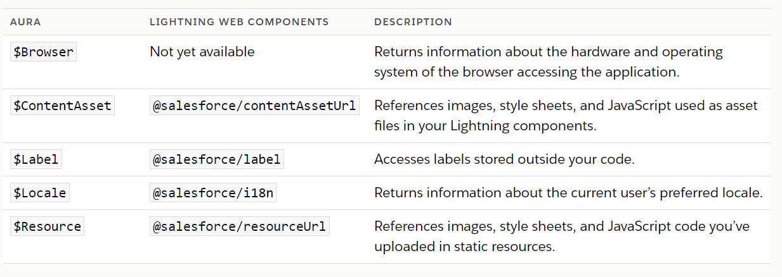
Migrate Global Value Providers
Migration markup
Migrate global value providers in an Aura component to scoped module imports in a Lightning web component.
Notes:
ASG – Would need to be ready by Juen for the certified to sell – 3 mo in certified to sell. To show it off at dreamforce 2019.
App exchange I splanned for the solution. If it’s just an asset then they want to review our architecture.
We don’t’ want this on the app exchange.
Approval is all of us, Chandu,. He delegated Subhojit to be our architect.
LWC v Aura – need to be able to regenerate the components with a future technology if needed. Kiran, is the look and feel different, how would that be done?
Security is not yet future proof
Vivek – security team – AERS design
Could we add Louisiana in the mix, to design not to break it in the future – master mapping exercise in the govCONNECT model – if you’re a state with x, here is how you would map to our roles
Let’s make conscious decisions together.
CO – you configure the call, and ti calls an interface, and the framework handles how to call the interface and the elments that are prepopulated.

Slide 13
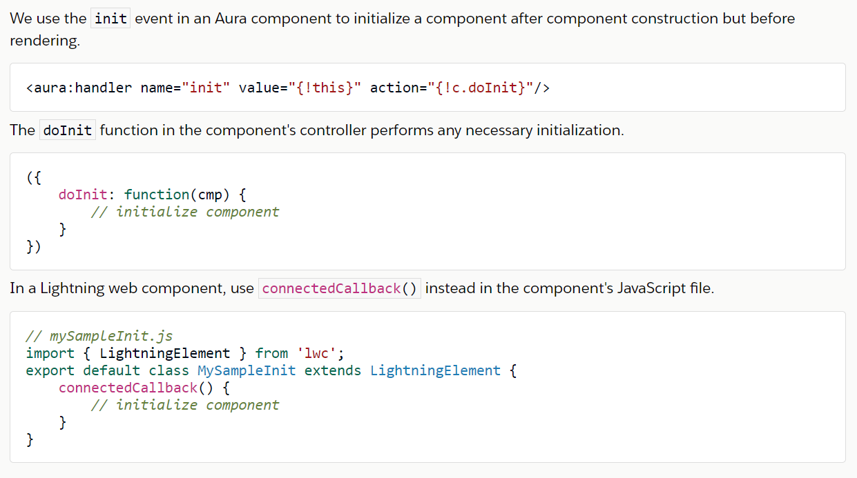
Migrate Initializers
Migration markup
Replace an init event handler in an Aura component with the standard JavaScript connectedCallback() method in a Lightning web component.
Notes:
ASG – Would need to be ready by Juen for the certified to sell – 3 mo in certified to sell. To show it off at dreamforce 2019.
App exchange I splanned for the solution. If it’s just an asset then they want to review our architecture.
We don’t’ want this on the app exchange.
Approval is all of us, Chandu,. He delegated Subhojit to be our architect.
LWC v Aura – need to be able to regenerate the components with a future technology if needed. Kiran, is the look and feel different, how would that be done?
Security is not yet future proof
Vivek – security team – AERS design
Could we add Louisiana in the mix, to design not to break it in the future – master mapping exercise in the govCONNECT model – if you’re a state with x, here is how you would map to our roles
Let’s make conscious decisions together.
CO – you configure the call, and ti calls an interface, and the framework handles how to call the interface and the elments that are prepopulated.

Slide 14
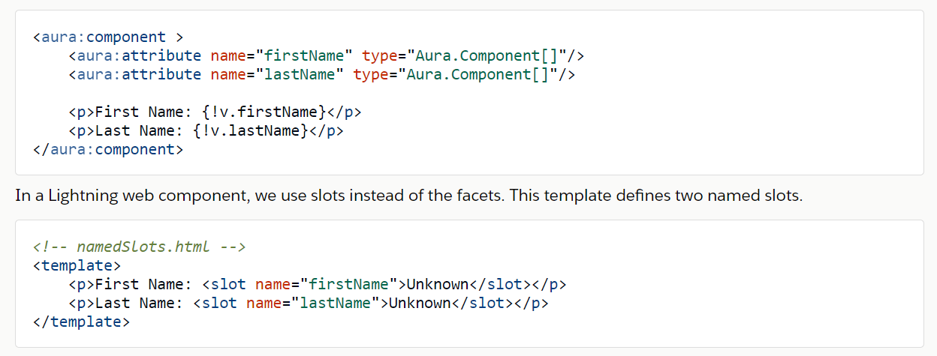
Migrate Facets
Migration markup
Migrate a facet in an Aura component to a slot in a Lightning web component.
Notes:
ASG – Would need to be ready by Juen for the certified to sell – 3 mo in certified to sell. To show it off at dreamforce 2019.
App exchange I splanned for the solution. If it’s just an asset then they want to review our architecture.
We don’t’ want this on the app exchange.
Approval is all of us, Chandu,. He delegated Subhojit to be our architect.
LWC v Aura – need to be able to regenerate the components with a future technology if needed. Kiran, is the look and feel different, how would that be done?
Security is not yet future proof
Vivek – security team – AERS design
Could we add Louisiana in the mix, to design not to break it in the future – master mapping exercise in the govCONNECT model – if you’re a state with x, here is how you would map to our roles
Let’s make conscious decisions together.
CO – you configure the call, and ti calls an interface, and the framework handles how to call the interface and the elments that are prepopulated.

Slide 15
Migrate Facets
Migration markup
Migrate a facet in an Aura component to a slot in a Lightning web component.
Notes:
ASG – Would need to be ready by Juen for the certified to sell – 3 mo in certified to sell. To show it off at dreamforce 2019.
App exchange I splanned for the solution. If it’s just an asset then they want to review our architecture.
We don’t’ want this on the app exchange.
Approval is all of us, Chandu,. He delegated Subhojit to be our architect.
LWC v Aura – need to be able to regenerate the components with a future technology if needed. Kiran, is the look and feel different, how would that be done?
Security is not yet future proof
Vivek – security team – AERS design
Could we add Louisiana in the mix, to design not to break it in the future – master mapping exercise in the govCONNECT model – if you’re a state with x, here is how you would map to our roles
Let’s make conscious decisions together.
CO – you configure the call, and ti calls an interface, and the framework handles how to call the interface and the elments that are prepopulated.

Slide 16
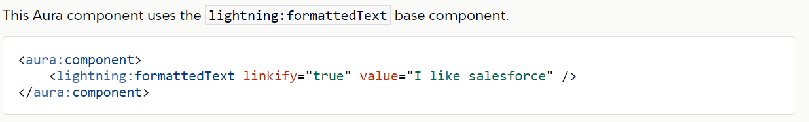
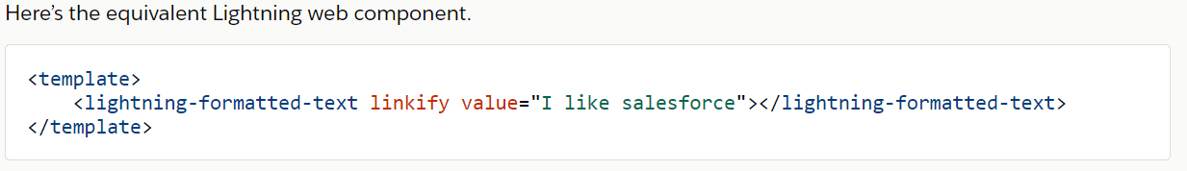
Migrate Base Components
Migration markup
Base Lightning components have a different syntax when you use them in the two programming models. Base Lightning components are building blocks that Salesforce provides in the lightning namespace.
Notes:
ASG – Would need to be ready by Juen for the certified to sell – 3 mo in certified to sell. To show it off at dreamforce 2019.
App exchange I splanned for the solution. If it’s just an asset then they want to review our architecture.
We don’t’ want this on the app exchange.
Approval is all of us, Chandu,. He delegated Subhojit to be our architect.
LWC v Aura – need to be able to regenerate the components with a future technology if needed. Kiran, is the look and feel different, how would that be done?
Security is not yet future proof
Vivek – security team – AERS design
Could we add Louisiana in the mix, to design not to break it in the future – master mapping exercise in the govCONNECT model – if you’re a state with x, here is how you would map to our roles
Let’s make conscious decisions together.
CO – you configure the call, and ti calls an interface, and the framework handles how to call the interface and the elments that are prepopulated.

Slide 17
Migrate Component Bundle Files

Slide 18
Migration Component Bundle Files
Migrate component bundle files
RESOURCE | AURA FILE | LIGHTNING WEB COMPONENTS FILE
Markup | sample.cmp | sample.html
Controller | sampleController.js | sample.js
Helper | sampleHelper.js | sample.js
Renderer | sampleRenderer.js | sample.js
CSS | sample.css | sample.css
Documentation | sample.auradoc | Not currently available
Design | sample.design | sample.js-meta.xml
SVG | sample.svg | Not currently available
https://developer.salesforce.com/docs/component-library/documentation/lwc/lwc.migrate_bundles
Notes:
ASG – Would need to be ready by Juen for the certified to sell – 3 mo in certified to sell. To show it off at dreamforce 2019.
App exchange I splanned for the solution. If it’s just an asset then they want to review our architecture.
We don’t’ want this on the app exchange.
Approval is all of us, Chandu,. He delegated Subhojit to be our architect.
LWC v Aura – need to be able to regenerate the components with a future technology if needed. Kiran, is the look and feel different, how would that be done?
Security is not yet future proof
Vivek – security team – AERS design
Could we add Louisiana in the mix, to design not to break it in the future – master mapping exercise in the govCONNECT model – if you’re a state with x, here is how you would map to our roles
Let’s make conscious decisions together.
CO – you configure the call, and ti calls an interface, and the framework handles how to call the interface and the elments that are prepopulated.

Slide 19
Mapping of Aura Interfaces to Lightning Web Components
Migrate component bundle files
LIGHTNING AURA COMPONENT | LIGHTING WEB COMPONENT | DESCRIPTION
lightning:hasPageReference | import { CurrentPageReference } from 'lightning/navigation'; @wire(CurrentPageReference) pageRef; | Indicates that the component accepts a PageReference.
flexipage:availableForAllPageTypes | In *.js-meta.xml: <target>lightning__AppPage</target> <target>lightning__RecordPage</target> <target>lightning__HomePage</target> </targets> | Indicates that the component is available for record pages and any other type of pages. Specify each page type explicitly as a target
flexipage:availableForRecordHome | import { LightningElement, api } from 'lwc'; @api recordId; In *.js-meta.xml: <targets> <target>lightning__RecordPage</target> </targets> | Indicates that the component takes a record Id as an attribute.
forceCommunity:availableForAllPageTypes | In *.js-meta.xml: <targets> <target>lightningCommunity__Page</target> </targets> | Indicates that the component can be used in Community Builder
Notes:
ASG – Would need to be ready by Juen for the certified to sell – 3 mo in certified to sell. To show it off at dreamforce 2019.
App exchange I splanned for the solution. If it’s just an asset then they want to review our architecture.
We don’t’ want this on the app exchange.
Approval is all of us, Chandu,. He delegated Subhojit to be our architect.
LWC v Aura – need to be able to regenerate the components with a future technology if needed. Kiran, is the look and feel different, how would that be done?
Security is not yet future proof
Vivek – security team – AERS design
Could we add Louisiana in the mix, to design not to break it in the future – master mapping exercise in the govCONNECT model – if you’re a state with x, here is how you would map to our roles
Let’s make conscious decisions together.
CO – you configure the call, and ti calls an interface, and the framework handles how to call the interface and the elments that are prepopulated.

Slide 20
Migrate CSS

Slide 21
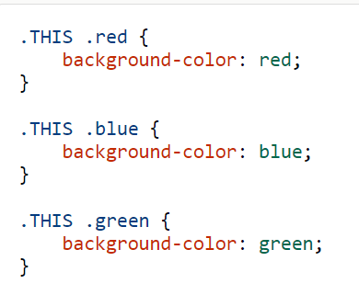
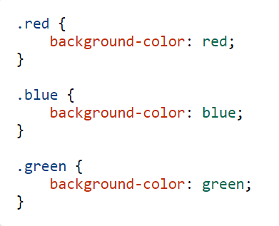
Migrate CSS
Migrate CSS
CSS file for an Aura component
CSS file for the migrated Lightning web component
Notes:
ASG – Would need to be ready by Juen for the certified to sell – 3 mo in certified to sell. To show it off at dreamforce 2019.
App exchange I splanned for the solution. If it’s just an asset then they want to review our architecture.
We don’t’ want this on the app exchange.
Approval is all of us, Chandu,. He delegated Subhojit to be our architect.
LWC v Aura – need to be able to regenerate the components with a future technology if needed. Kiran, is the look and feel different, how would that be done?
Security is not yet future proof
Vivek – security team – AERS design
Could we add Louisiana in the mix, to design not to break it in the future – master mapping exercise in the govCONNECT model – if you’re a state with x, here is how you would map to our roles
Let’s make conscious decisions together.
CO – you configure the call, and ti calls an interface, and the framework handles how to call the interface and the elments that are prepopulated.

Slide 22
Migrate Events

Slide 23
Migrate Events
Migrate events
Migrate Registered Events
There's no equivalent in Lightning web components for the <aura:registerEvent> tag in Aura component markup to register that a component can fire an event.
Migrate Event Handlers
There's no equivalent in Lightning web components for the <aura:handler> tag in Aura component markup that configures an event handler.
Migrate Access Controls
Migrate access controls for an Aura component to the appropriate value for <isExposed> in a Lightning web component’s configuration file. Migrate access controls for an attribute in an Aura component to the appropriate combination of a JavaScript property decorator and value for <isExposed>.
Notes:
ASG – Would need to be ready by Juen for the certified to sell – 3 mo in certified to sell. To show it off at dreamforce 2019.
App exchange I splanned for the solution. If it’s just an asset then they want to review our architecture.
We don’t’ want this on the app exchange.
Approval is all of us, Chandu,. He delegated Subhojit to be our architect.
LWC v Aura – need to be able to regenerate the components with a future technology if needed. Kiran, is the look and feel different, how would that be done?
Security is not yet future proof
Vivek – security team – AERS design
Could we add Louisiana in the mix, to design not to break it in the future – master mapping exercise in the govCONNECT model – if you’re a state with x, here is how you would map to our roles
Let’s make conscious decisions together.
CO – you configure the call, and ti calls an interface, and the framework handles how to call the interface and the elments that are prepopulated.

Slide 24
Migrate Standard Events
Migrate events
Create an event
Instead of the proprietary Event object in Aura components, use the Event or CustomEvent standard DOM objects. There's no equivalent in Lightning web components for the <aura:registerEvent> tag in Aura component markup to register that a component can fire an event.
Fire an event
Instead of event.fire() in an Aura component, use this.dispatchEvent(myEvent), which is a standard DOM method, in Lightning web components.
Handle an event
An Aura component uses the <aura:handler> tag in markup to define a handler. Alternatively a component can declare a handler action when it references another component in its markup. A Lightning web component can similarly declare a declarative handler. The event name in the declarative handler is prefixed by on.
Notes:
ASG – Would need to be ready by Juen for the certified to sell – 3 mo in certified to sell. To show it off at dreamforce 2019.
App exchange I splanned for the solution. If it’s just an asset then they want to review our architecture.
We don’t’ want this on the app exchange.
Approval is all of us, Chandu,. He delegated Subhojit to be our architect.
LWC v Aura – need to be able to regenerate the components with a future technology if needed. Kiran, is the look and feel different, how would that be done?
Security is not yet future proof
Vivek – security team – AERS design
Could we add Louisiana in the mix, to design not to break it in the future – master mapping exercise in the govCONNECT model – if you’re a state with x, here is how you would map to our roles
Let’s make conscious decisions together.
CO – you configure the call, and ti calls an interface, and the framework handles how to call the interface and the elments that are prepopulated.

Slide 25
Migrate events
LIGHTNING AURA COMPONENT | LIGHTNING WEB COMPONENT | DESCRIPTION
aura:locationChange | The hashchange browser event fires when a window's hash changes. To handle this event, use the onhashchange event handler. | Fired when the hash part of the URL in the browser's location bar has been modified.
aura:valueChange | Use properties with custom getter and setter methods. | Fired when a property value has changed.
aura:valueDestroy | Use the disconnectedCallback()lifecycle hook. | Fired when a component is destroyed.
aura:valueInit | To replace the init event handler, use the connectedCallback()lifecycle hook. | Fired when a component has been initialized.
aura:valueRender | Use the renderedCallback() or render() lifecycle hook. | Fired when a component has been rendered.
force:createRecord |  | Displays the record create panel.
force:editRecord |  | Displays the record edit panel.
force:navigateHome (deprecated) |  | Navigates to a record home page.
force:navigateToComponent(deprecated) |  | Navigates to a component.
force:navigateToList |  | Navigates to a list view.
force:navigateToObjectHome |  | Navigates to an object home page.
force:navigateToRelatedList |  | Navigates to a related list.
force:navigateToSObject |  | Navigates to a record.
force:navigateToURL |  | Navigates to a URL.
lightning:openFiles |  | Opens one or more file records.
force:showToast | Import the lightning/platformShowToastEventmodule. | Displays a toast message to alert users of a success, error, or warning..
ltng:afterScriptsLoaded | Import the static resource and import methods from the lightning/platformResourceLoadermodule. | Fired when ltng:require has loaded all scripts listed in ltng:require.scripts
Notes:
ASG – Would need to be ready by Juen for the certified to sell – 3 mo in certified to sell. To show it off at dreamforce 2019.
App exchange I splanned for the solution. If it’s just an asset then they want to review our architecture.
We don’t’ want this on the app exchange.
Approval is all of us, Chandu,. He delegated Subhojit to be our architect.
LWC v Aura – need to be able to regenerate the components with a future technology if needed. Kiran, is the look and feel different, how would that be done?
Security is not yet future proof
Vivek – security team – AERS design
Could we add Louisiana in the mix, to design not to break it in the future – master mapping exercise in the govCONNECT model – if you’re a state with x, here is how you would map to our roles
Let’s make conscious decisions together.
CO – you configure the call, and ti calls an interface, and the framework handles how to call the interface and the elments that are prepopulated.

Slide 26
Migrate JavaScript and Syntax Changes
Migrate events
Move JavaScript code from your client-side controller, helper, and renderer to the single JavaScript file in a Lightning web component.
This is not a line-by-line conversion, and it's a good opportunity to revisit your component's design.
Change the colon that separates the namespace and component name to a dash.
Change the camel case component name (formattedText) to a dash-separated name (formatted-text).
Remove the true or false value on the boolean attribute. If present, a boolean attribute denotes that its value is true.
Change the self-closing tag to a full closing tag (</lightning-formatted-text>).
Base Components : https://developer.salesforce.com/docs/component-library/documentation/lwc/lwc.migrate_map_aura_lwc_components
Notes:
ASG – Would need to be ready by Juen for the certified to sell – 3 mo in certified to sell. To show it off at dreamforce 2019.
App exchange I splanned for the solution. If it’s just an asset then they want to review our architecture.
We don’t’ want this on the app exchange.
Approval is all of us, Chandu,. He delegated Subhojit to be our architect.
LWC v Aura – need to be able to regenerate the components with a future technology if needed. Kiran, is the look and feel different, how would that be done?
Security is not yet future proof
Vivek – security team – AERS design
Could we add Louisiana in the mix, to design not to break it in the future – master mapping exercise in the govCONNECT model – if you’re a state with x, here is how you would map to our roles
Let’s make conscious decisions together.
CO – you configure the call, and ti calls an interface, and the framework handles how to call the interface and the elments that are prepopulated.

Slide 27
References
references
https://developer.salesforce.com/docs/component-library/documentation/lwc/migrate_introduction
https://trailhead.salesforce.com/en/content/learn/modules/lightning-web-components-for-aura-developers/understand-how-lightning-web-components-work-with-aura-components
Notes:
ASG – Would need to be ready by Juen for the certified to sell – 3 mo in certified to sell. To show it off at dreamforce 2019.
App exchange I splanned for the solution. If it’s just an asset then they want to review our architecture.
We don’t’ want this on the app exchange.
Approval is all of us, Chandu,. He delegated Subhojit to be our architect.
LWC v Aura – need to be able to regenerate the components with a future technology if needed. Kiran, is the look and feel different, how would that be done?
Security is not yet future proof
Vivek – security team – AERS design
Could we add Louisiana in the mix, to design not to break it in the future – master mapping exercise in the govCONNECT model – if you’re a state with x, here is how you would map to our roles
Let’s make conscious decisions together.
CO – you configure the call, and ti calls an interface, and the framework handles how to call the interface and the elments that are prepopulated.

Slide 28
Questions

Slide 29
1. Which is the correct format to write the following component name in LWC? (Component Name – ‘thisIsSampleComponent’)
this_Is_Sample_Component
this-Is-Sample-Component
this-is-sample-component
thisIsSampleComponent
2. How do you use ‘init’ initializer in LWC
a. connectedCallBack(){}
b. connectedcallback(){}
c. ConnectedCallBack(){}
d. connectedCallback(){}
3. How do you use facets in LWC?
a. {!v.FirstName}
b. <slot name=“FirstName”> </slot>
c. {FirstName}
d. {c.FirstName}
4. Which of the following resources from aura bundle doesn’t have a corresponding file in LWC ?
a. sampleHelper.js, sampleRenderer.js
b. sample.auradoc, sample.svg
c. sample.design, sample.svg
d. sample.css, sampleController.js
Notes:
ASG – Would need to be ready by Juen for the certified to sell – 3 mo in certified to sell. To show it off at dreamforce 2019.
App exchange I splanned for the solution. If it’s just an asset then they want to review our architecture.
We don’t’ want this on the app exchange.
Approval is all of us, Chandu,. He delegated Subhojit to be our architect.
LWC v Aura – need to be able to regenerate the components with a future technology if needed. Kiran, is the look and feel different, how would that be done?
Security is not yet future proof
Vivek – security team – AERS design
Could we add Louisiana in the mix, to design not to break it in the future – master mapping exercise in the govCONNECT model – if you’re a state with x, here is how you would map to our roles
Let’s make conscious decisions together.
CO – you configure the call, and ti calls an interface, and the framework handles how to call the interface and the elments that are prepopulated.

